Slide 1
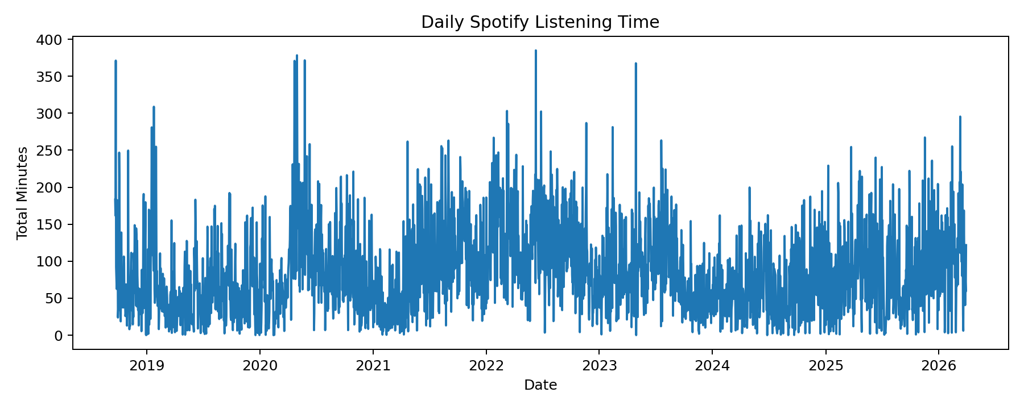
How Does My Spotify Listening Behavior Change on Special Days?
DSA210 Final Project Presentation
PROJECT
Main question: Does my Spotify listening behavior change across exams, deadlines, stress periods, vacations, and other meaningful days?
I studied both listening behavior and the character of the music I listened to.
The project includes data preparation, EDA, hypothesis testing, and machine learning.

Slide 2
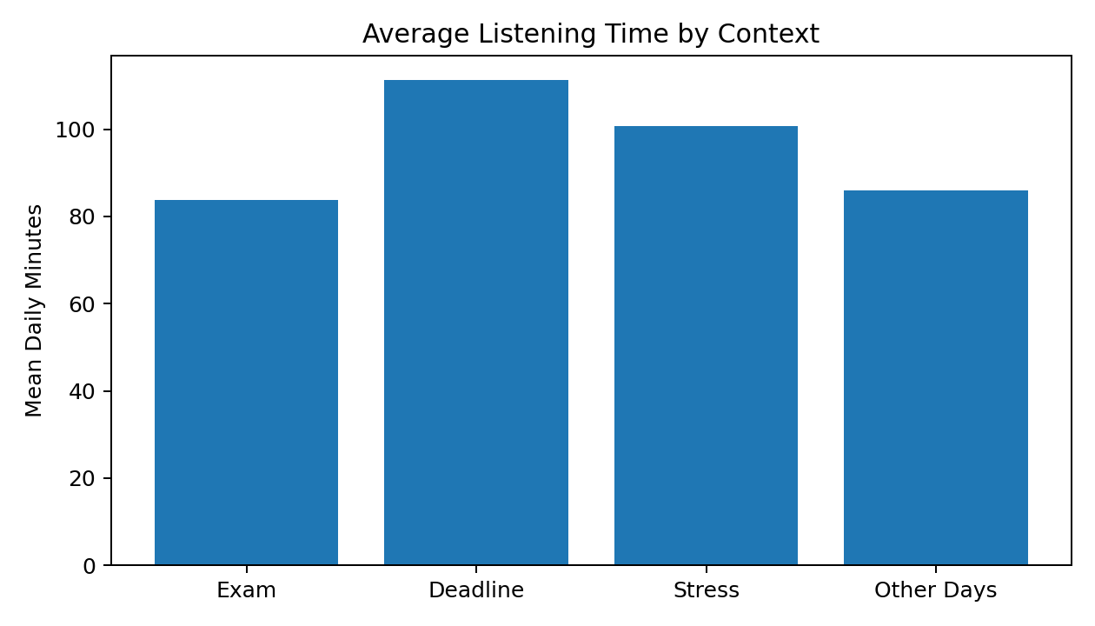
Data Sources and Preparation
DATA
Spotify Extended Streaming History from 2018 to 2026 was the main source.
Calendar-based labels were created for exams, deadlines, stress periods, and personal events.
Travel and break periods were added as another context source.
The event-level streaming data was cleaned and converted into a daily-level dataset.

Slide 3
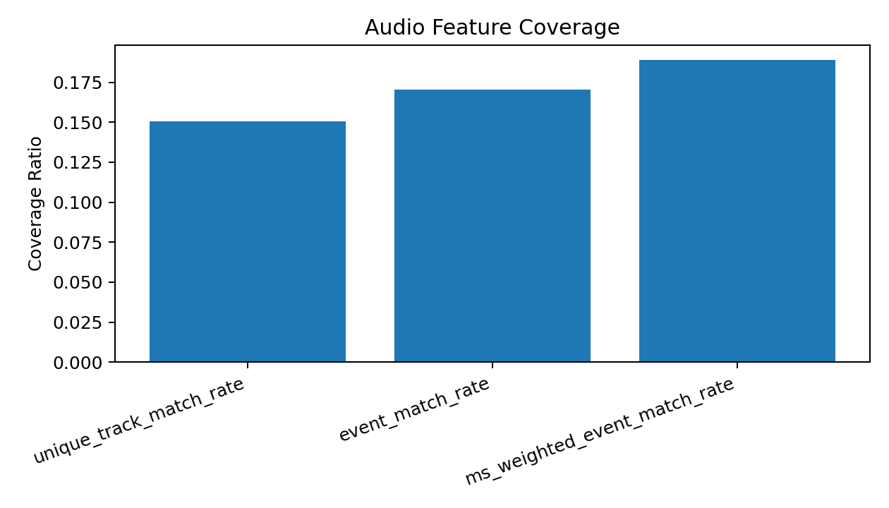
Audio Feature Enrichment
AUDIO
Audio features were not directly available in the cleaned Spotify dataset.
I built a track catalog from my local listening history and matched it with public music-feature datasets.
This added variables such as danceability, energy, valence, tempo, and acousticness.
The matched audio features were then aggregated to the daily level.
28,660 unique tracks in total
4,316 matched unique tracks
15.1% unique-track coverage
17.0% event-level coverage
18.9% ms-weighted coverage

Slide 4
EDA and Hypothesis Testing
ANALYSIS
I first explored changes in daily listening time, stream count, artist diversity, skip rate, and shuffle rate.
Then I compared special contexts such as exam days, deadline days, stress periods, vacations, and entrance-exam preparation periods.
Hypothesis tests were used to check whether some of the observed differences were statistically meaningful.
The overall result was that listening behavior was not stable and changed across several personal and academic contexts.

Slide 5
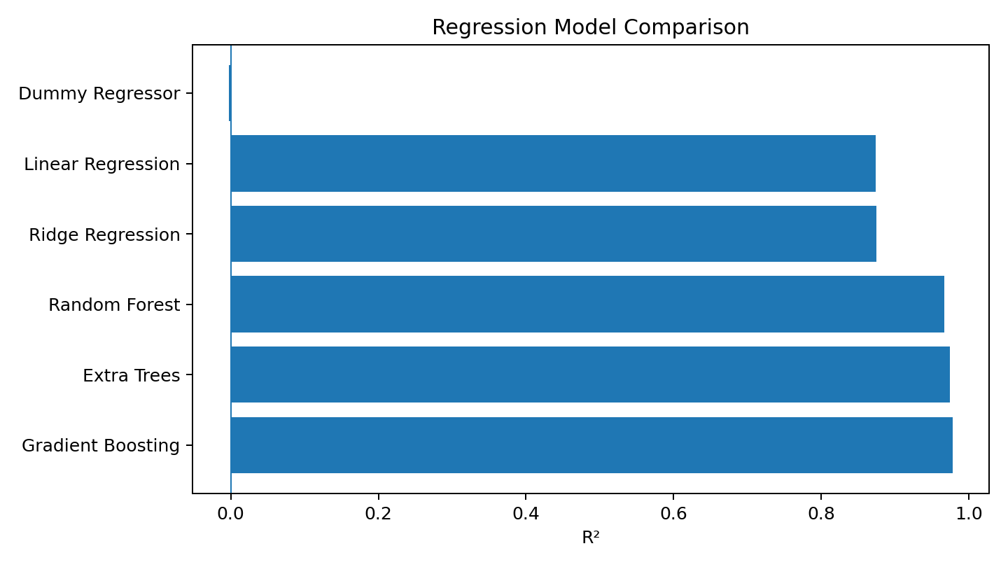
Machine Learning Methods
ML
The main ML notebook in the project is ml_methods_original.ipynb.
It focused on day-to-day listening change rather than only classifying special days.
Main target: total daily listening time (total_minutes).
Models used: Dummy Regressor, Linear Regression, Ridge Regression, Random Forest, Extra Trees, and Gradient Boosting.
A chronological train-test split, cross-validation, tuning, feature importance, and residual analysis were included.

Slide 6
Main ML Results
RESULTS
Best regression model: Gradient Boosting
MAE ≈ 5.14, RMSE ≈ 8.06, R² ≈ 0.978
Extra Trees and Random Forest were also strong.
The strongest predictors were mostly behavioral: num_streams, avg_stream_length, minutes_per_stream, and recent listening trend variables.
Audio features contributed, but they were not the main drivers.

Slide 7
Important Interpretation
READ CAREFULLY
The high R² values should be interpreted carefully.
Some predictors were very close to the target total_minutes, such as num_streams, avg_stream_length, and minutes_per_stream.
Because of this, the ML model is more descriptive and explanatory than fully independent and predictive.
This point was treated as an important feedback item in the final interpretation.
Still, the model shows that daily Spotify listening behavior has a clear structure and changes meaningfully across days.

Slide 8
Limitations and Improvements
LIMITATIONS
This is a single-user dataset, so the findings are personal.
Calendar-based special-day coverage is limited to certain periods.
Audio-feature coverage is limited: 15.1% of unique tracks and 17.0% of event rows.
A more detailed calendar record would make the behavior side more consistent.
A better music-type or genre dataset would strengthen the music-character side.

Slide 9
Conclusion
FINAL
Spotify listening behavior is not constant across days.
Listening intensity changes across exams, deadlines, stress periods, vacations, and other contexts.
The strongest signal comes from listening structure and intensity.
Audio features add useful information, but their contribution is smaller because coverage is limited.
Overall, the project shows that daily routine and personal context are closely related to music listening behavior.

